Slide 1


Slide 2
Orphism, Futurism & Neoplasticism

Slide 3
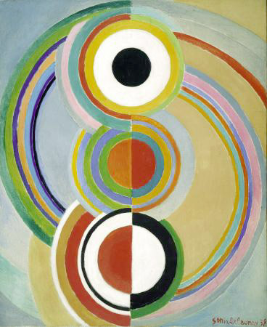
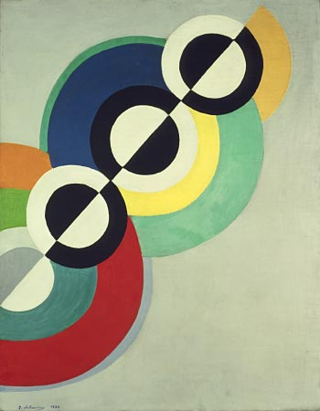
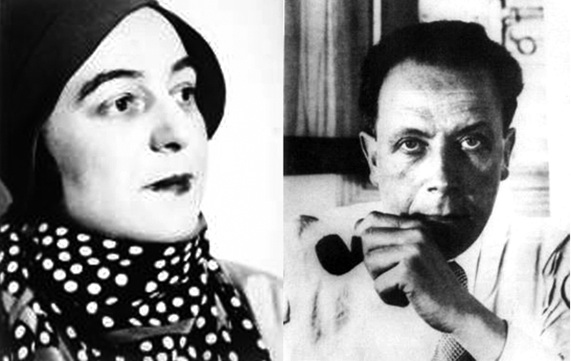
Living Simultaneously:
Sonia & Robert Delaunay
“We were two moving forces.
One made one thing and one made the other.”

Slide 4
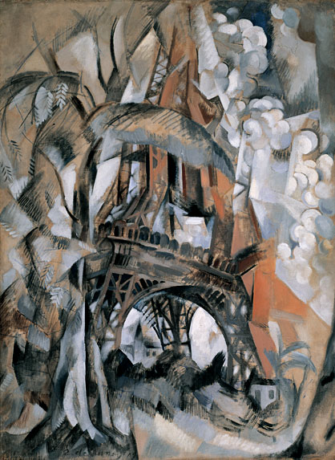
Robert Delaunay, Eiffel Tower with Trees, 1910, oil on canvas, 50 x 36 1/2 in., Guggenheim
“Seeing is in itself a movement. Vision is the true creative rhythm. Discerning the quality of rhythms is a movement, and the essential quality of painting is representation the movement of vision which functions in objectivizing itself toward reality. That is the essential of art, and its greatest profoundness.”
- Robert Delaunay

Slide 5
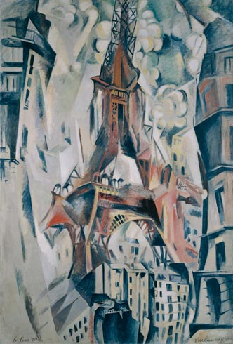
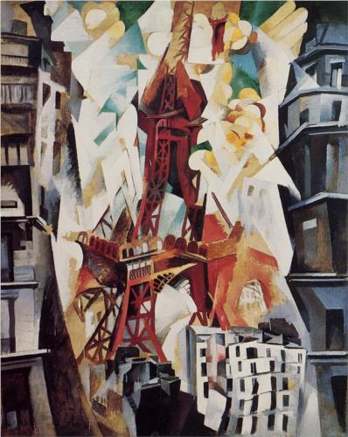
Robert Delaunay, Eiffel Tower, (left) 1911 (dated 1910 by the artist, 79x54”); (right) Eiffel Tower, 1909-1914, oil on canvas, Orphism.

Slide 6
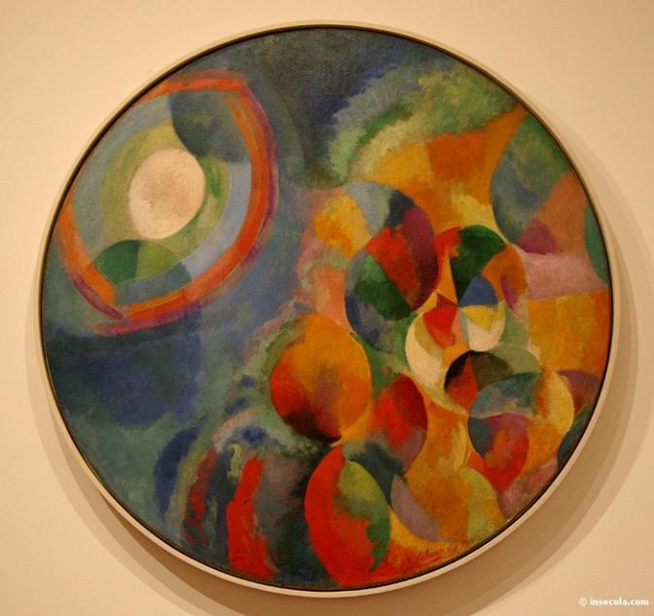
Robert Delaunay (French 1885-1941) Simultaneaous Contrasts: Sun and Moon, 53 in. diameter, 1912-13, MoMA NYC
Orphism
Influence of Chevreul’s theories of the effects of juxtaposed colors expanded by the Delaunays into a practice of “simultaneity” - roughly defined as the process by which one entity gains its identity through contrast with another.

Slide 7
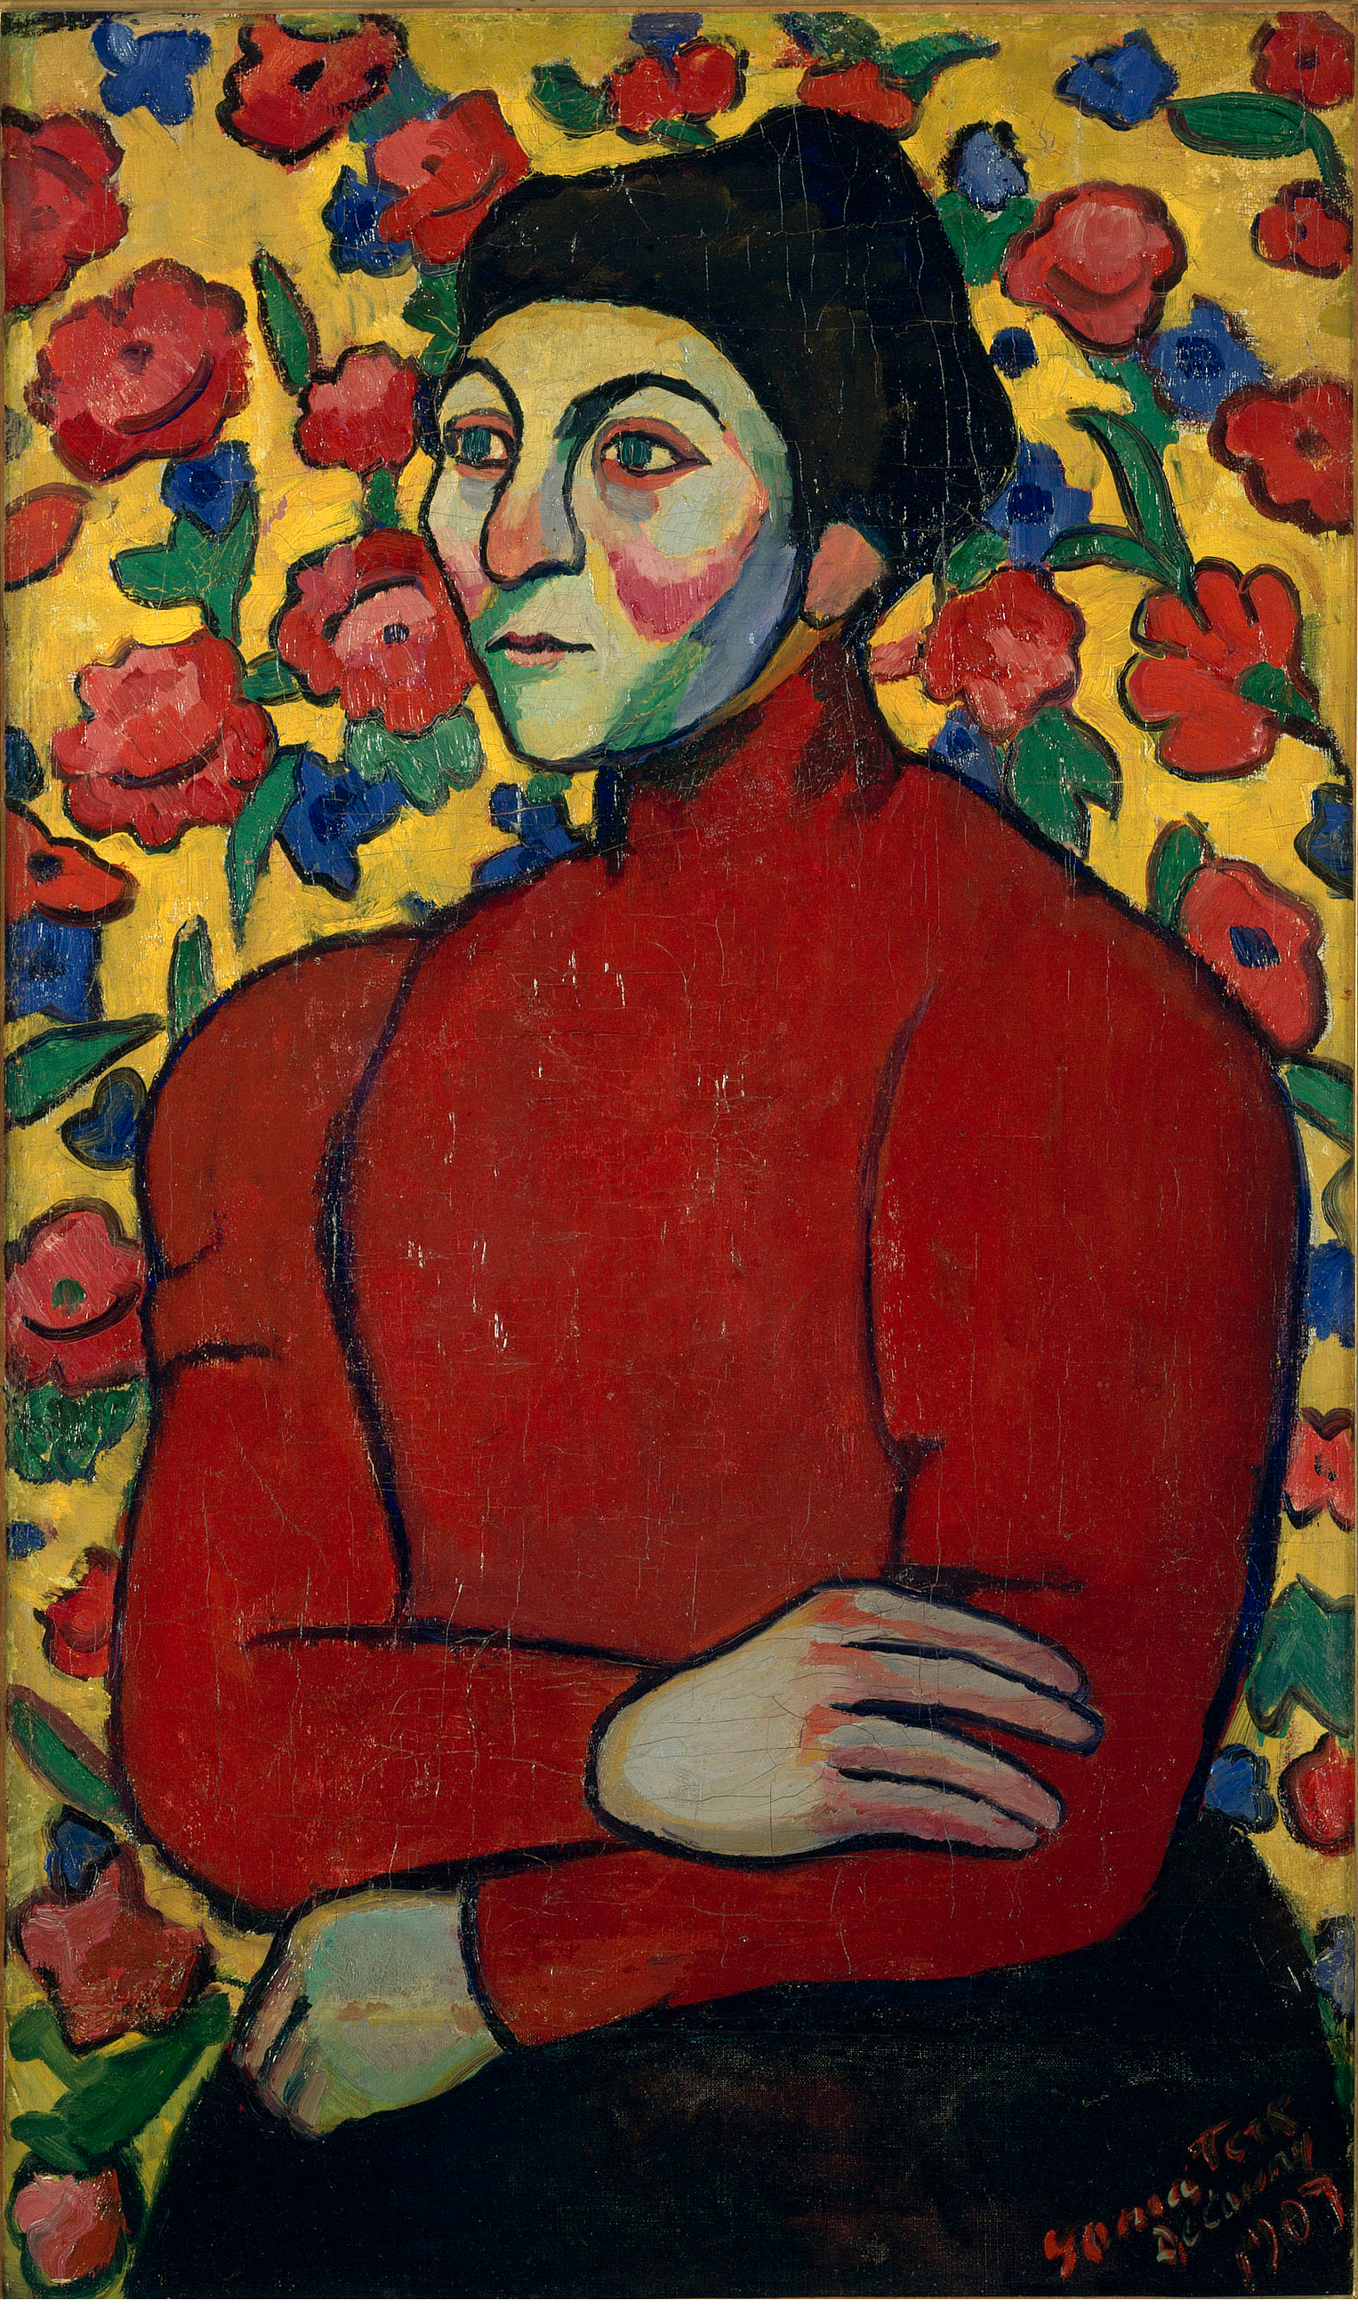
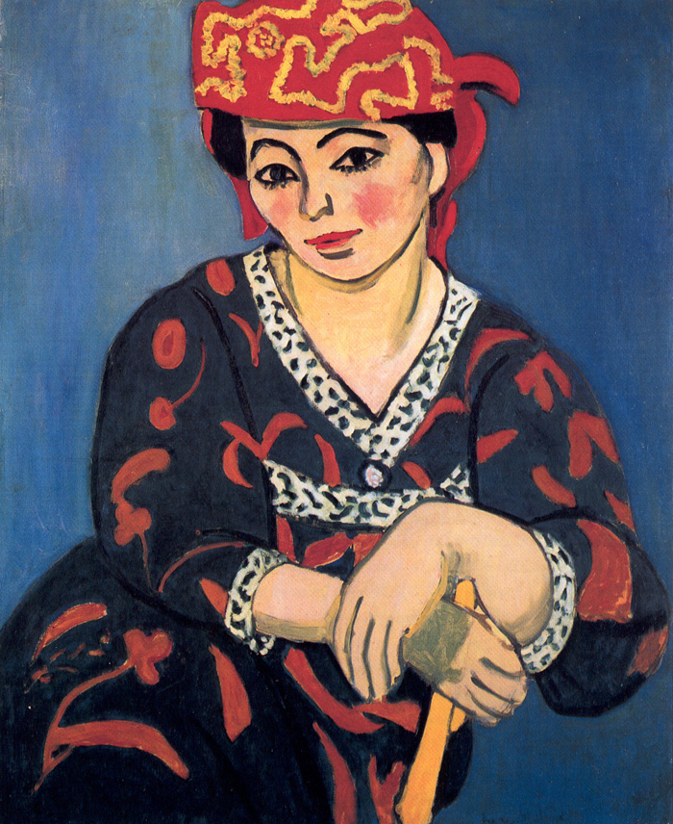
Sonia Delaunay (b. Sonia Stern, reared Sonia Terk; Ukrainian-French 1885-1979) painter, installation and performance artist and designer), Philomene, oil on canvas, 1907, two years after she arrived in Paris. Russian Fauvism
Matisse, Madras Rouge, 1907

Slide 8
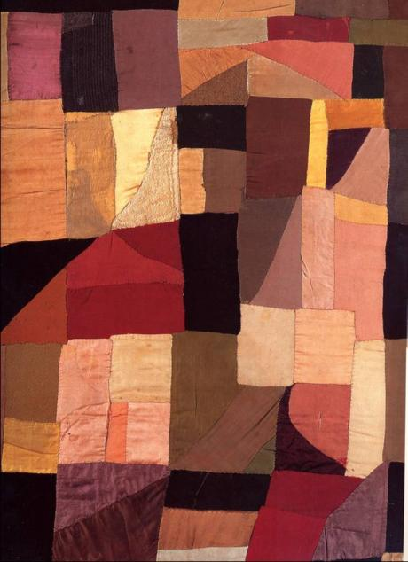
Sonia Delaunay, Quilt, 1911, fabric, 43 x 32 in, Musee National d’Art Moderne, Pompidou Center, Paris. Cubism and traditional domestic art by women
"About 1911 I had the idea of making for my son, who had just been born, a blanket composed of bits of fabric like those I had seen in the houses of Russian peasants. When it was finished, the arrangement of the pieces of material seemed to me to evoke cubist conceptions and we then tried to apply the same process to other objects and paintings."
Sonia Delaunay

Slide 9
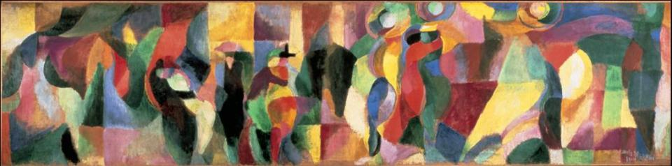
Sonia Delaunay, The Bal Boulier, 1912, 20 x 29”, oil on canvas, Musée d’Art Moderne, Paris.
The first living female artist to have a retrospective exhibition at the Louvre (1964)

Slide 10
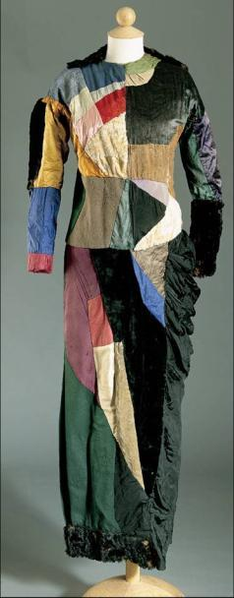
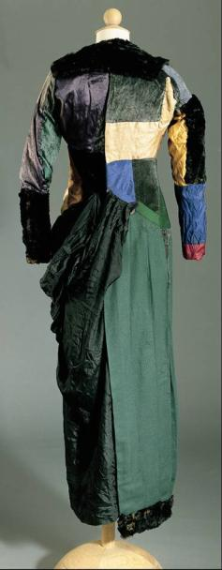
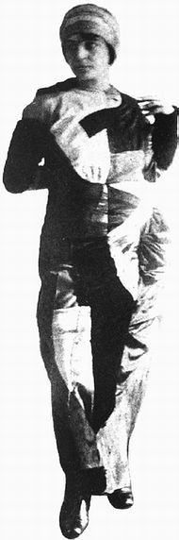
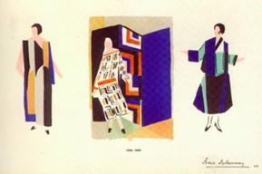
Sonia’s dress for dancing at the Bal Boulier with Robert and friends, 1912. Robert wore a multicolored suit designed by Sonia and fabricated by a tailor.
Delaunay, Simultaneous fashion
Designs, 1924

Slide 11
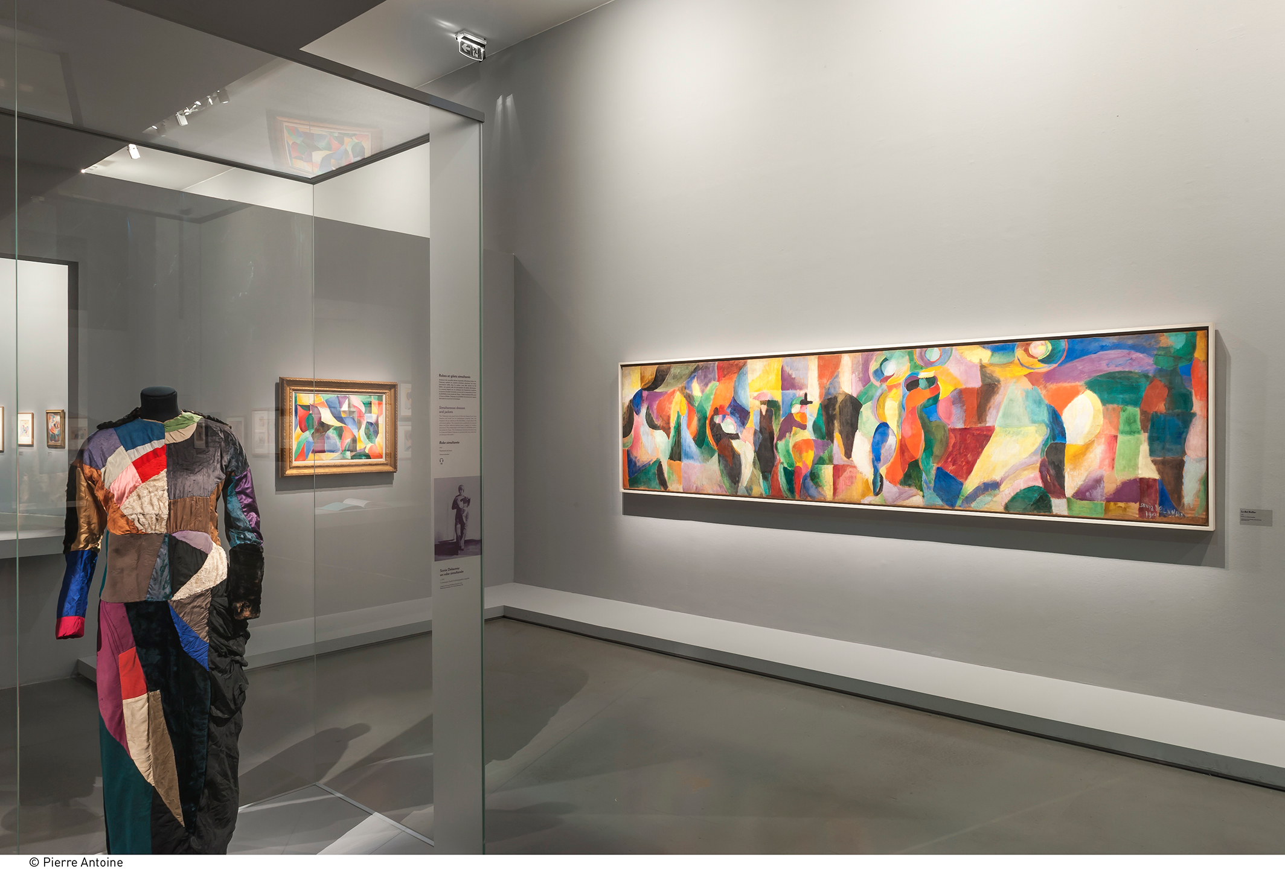
Sonia Delaunay gallery, Pompidou Center, Paris

Slide 12
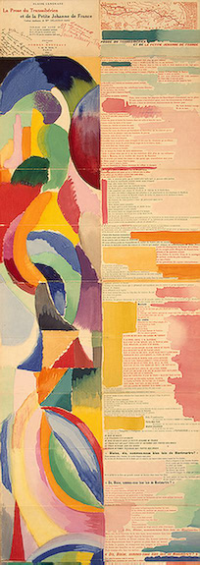
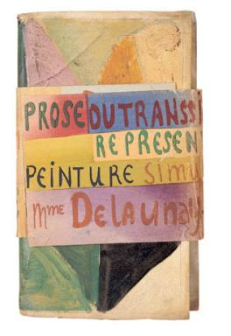
Sonia Delaunay, Prose of the Transiberian, collaborative work with poet Blaise Cendrars, 1913, folded (above) and (right) unfolded view: 6’ x 1’

Slide 13
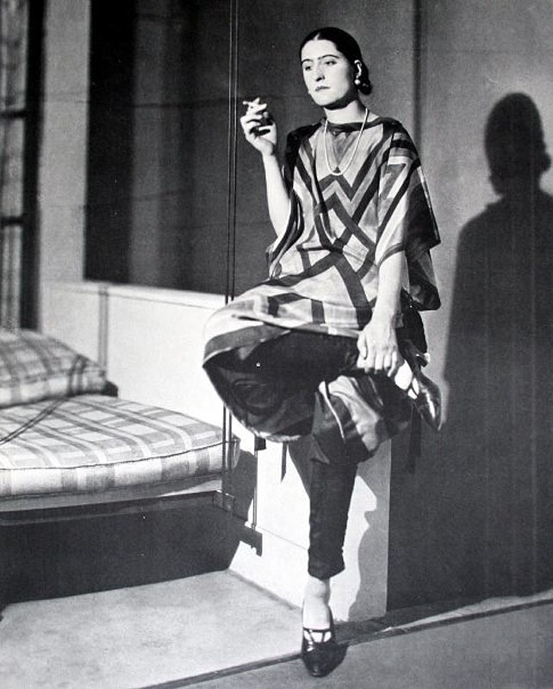
Delaunay in 1920 wearing her design

Slide 14
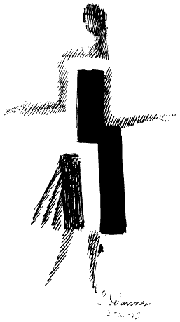
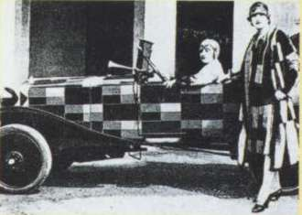
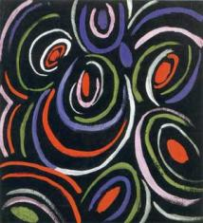
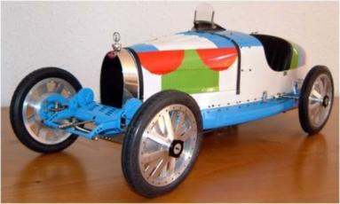
Sonia Delaunay simultaneous designs for the 1925 Paris 'Exposition Internationale des Arts Decoratifs et Industriels Modernes‘ (Art Deco)
“cubist” fashion
design
“Orphic” textile design
Contemporary restoration
of a Delaunay design

Slide 15
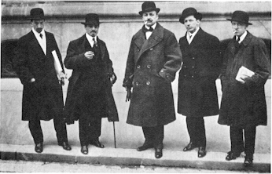
Italian Futurists in Paris, February 1912
L to R: Luigi Russolo, Carlo Carra, F.T. Marinetti, Umberto Boccioni, Gino Severini
“We want to glorify war - the only cure for the world - militarism, patriotism, the destructive gesture of the anarchists, the beautiful ideas which kill, and contempt for woman.
We want to demolish museums and libraries, fight morality, feminism and all opportunist and utilitarian cowardice.“
- Marinetti, Futurist Manifesto published in French in Le Figaro (Paris) on 20 February 1909

Slide 16
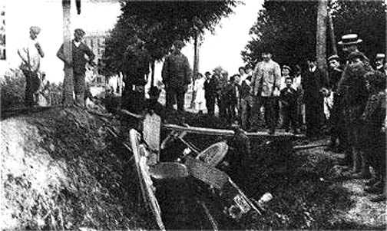
F.T. Marinetti’s crashed car referred to in the Futurist Manifesto, 1909
“Oh, maternal ditch, half full of muddy water! A factory gutter! I savored a mouthful of strengthening muck which recalled the black teat of my Sudanese nurse! As I raised my body, mud-spattered and smelly, I felt the red hot poker of joy deliciously pierce my heart.”
- Marinetti
“We thought it was dead, my good shark, but I woke it
with a single caress of its powerful back,…”

Slide 17
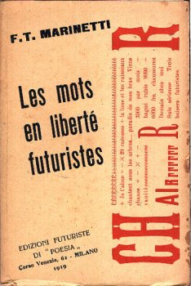
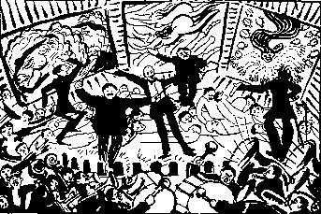
(left) Umberto Boccioni, Futurist Evening, 1914, pen & ink drawing
(right) Filippo Tommaso Marinetti, Words in Liberty, 1919, “words in freedom and destruction of syntax”

Slide 18
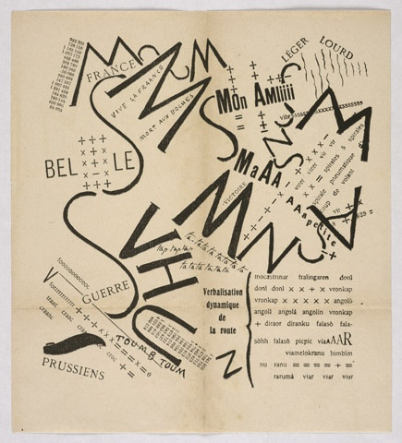
Filippo Marinetti, After the Marne, Joffre Visits the Front by Car, 1915

Slide 19
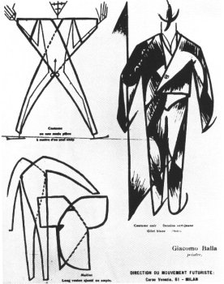
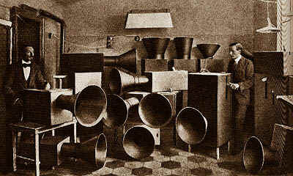
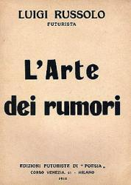
Giacomo Balla, Futurist Manifesto of Men’s Clothing, 1913
Luigi Russolo (Italian painter, 1885-1947), & Francesco Balilia Pratella, Futurist Music 1910-1920; Russolo, L’Arte dei rumori (The Art of Noise) manifesto cover, 1916, Milan
"Ancient life was all silence. In the nineteenth century, wlth the invention of the machine, noise was born. Today, noise triumphs and reigns supreme over the sensibilities of men."
Luigi Russolo, The Art of Noise, 1913

Slide 20
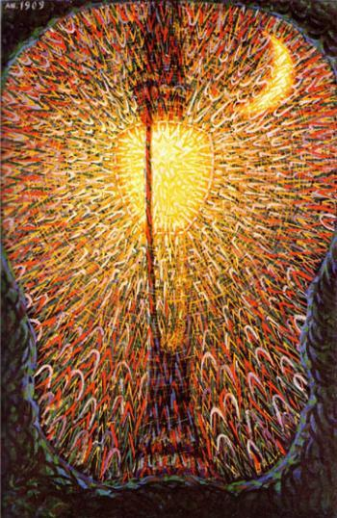
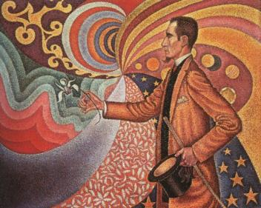
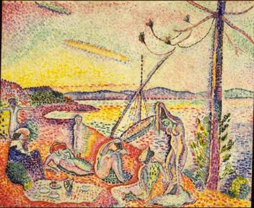
Giacomo Balla (Italian, 1871-1958), Street Light (Lampada - Studio di luce), 1909, oil on canvas, 68 3/4 x 45 1/4 inches (174.7 x 114.7 cm), Museum of Modern Art, NY compare: Paul Signac (French Neo-Impressionist), Opus 217: Portrait of M. Fénéon in 1890, 1890; and Henri Matisse, Luxe, Calme, et Volupté, 1904-5

Slide 21
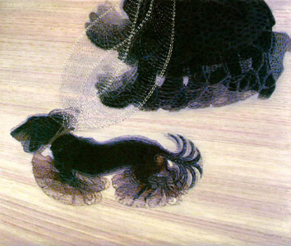
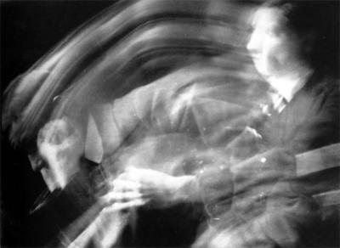
Giacomo Balla, Dynamism of a Dog on a Leash (Leash in Motion), 1912 oil on canvas, 35 x 45”
Antonio Bragaglia, Change of Position, 1911, gelatin-silver print

Slide 22
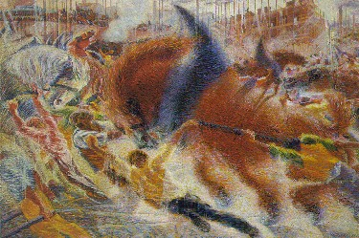
Umberto Boccioni (Italian, 1882-1916), The City Rises, 1910, 6’6” x 9’10”, MoMA NYC

Slide 23
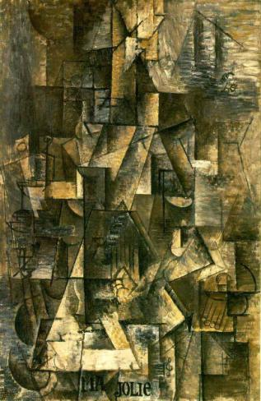
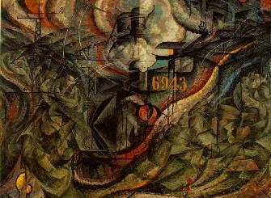
Umberto Boccioni, States of Mind I: The Farewells, 1911 (Futurism) compare: Picasso, Ma Jolie, 1911 (Analytic Cubism)

Slide 24
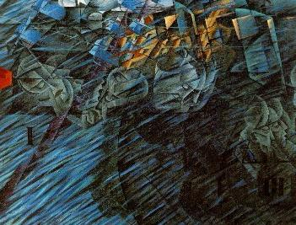
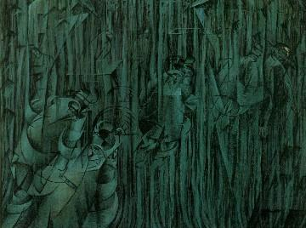
Umberto Boccioni, States of Mind 2 & 3: Those who Go (left) and Those Who Stay (right),1911

Slide 25
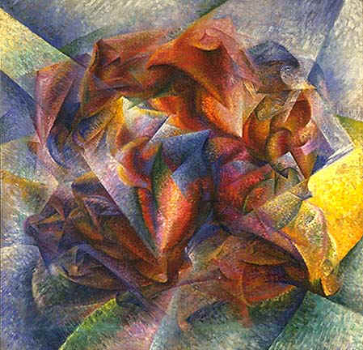
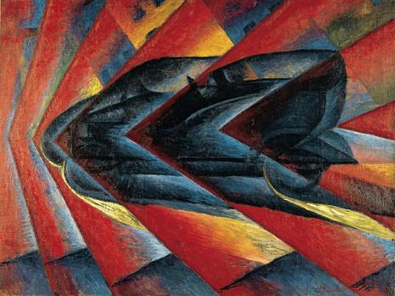
Luigi Russolo (left), Dynamism of an Automobile, 1912-1913, oil on canvas, 106 x 140 cm., Pompidou Center, Paris
Umberto Boccioni (right), Dynamism of a Soccer Player, 1913, 6' 4" x 6' 7“, MoMA, NYC
“Our bodies penetrate the sofas on which we sit; and the sofas penetrate our bodies.” Boccioni, Futurist Painting Manifesto

Slide 26
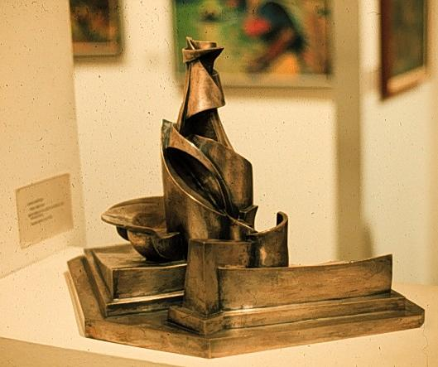
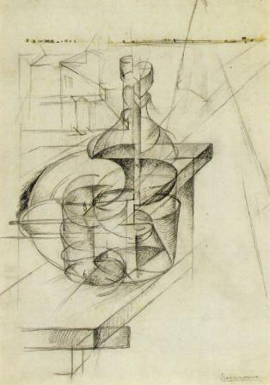
Umberto Boccioni, Development of a Bottle in Space, 1912, silvered bronze, 15” high, MoMA NYC
(right) Boccioni, Table + Bottle + House, 1912, pencil on paper

Slide 27
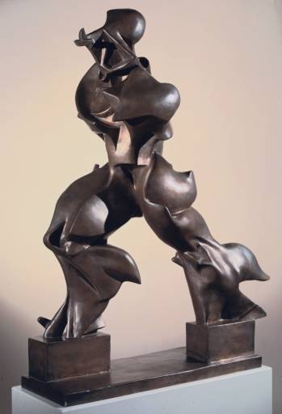
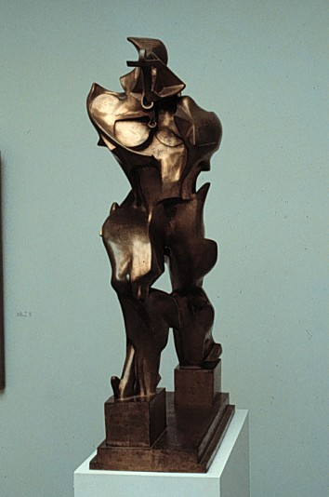
Umberto Boccioni, Unique Forms of Continuity in Space, 44 x 35 x 16 in, bronze, 1913, two views

Slide 28
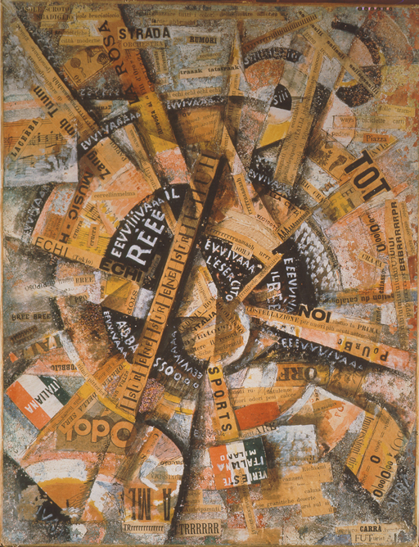
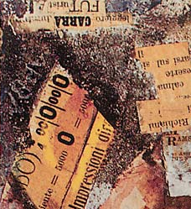
Carlo Carrà (Italian Futurist, 1881-1966), Interventionist Manifesto (or Patriotic Celebration: Free Word Painting), pasted paper on cloth, mounted on wood, 15” x 12”, 1914

Slide 29
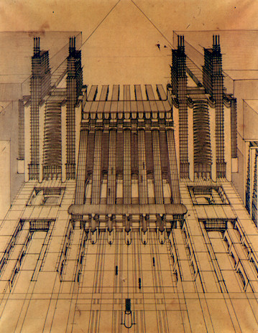

Antonio Sant’Elia (Italian 1888-1916), Train and plane station (left) and power plant for Futurist Città Nuovo, 1914, ink on paper

Slide 30

(L-R) Antonio Sant’Elia, Boccioni, and Marinetti as WWI soldiers, 1915
Italy's wartime casualties : 420,000 killed and almost 955,000 wounded.

Slide 31


Slide 32


Emilio Pettoruti (Argentina 1892-1970) Studied and worked in Italy, France, and Germany 1913-1920s.
Argentine Avant-Garde was launched in 1924 with the founding in Buenos Aires of the avant-garde magazine, Martin Fierro and the controversial exhibition of paintings by Emilio Pettoruti later the same year.
Martin Fierro’s manifesto – “…we are in the presence of a NEW SENSIBILITY and of a NEW COMPREHENSION” and “new means and forms of expression.” (caps in original)
Luigi Russolo, Dynamism of an
Automobile, 1913, oil, Italian Futurism
Emilio Pettoruti, Dynamism, graphite,
1915, Argentine Futurism

Slide 33

Still from Cabaret 13 a Futurist film with Natalya Goncharova (Russian, 1881-1962) and Mikail Larionov (Russian, 1881-1964) with Futurist face paint and graffiti at the door of Cabaret 13

Slide 34


Natalya Goncharova, Saint Michael, 1910, Neo-Primitivism (left) and (right) Linen, 1912, Russian Cubism/ Rayonism [cyrillic letters]

Slide 35

Mikhail Larionov, Blue Rayonism, 1912
"The style of Rayonist painting that we advance signifies spatial forms arising from the interjection of the reflected rays of various objects, forms chosen by the artist’s will.”

Slide 36



(left top) Piet Mondrian (Dutch, 1872-1944), Brabant Farmyard, 1904
(right) Mondrian, Tableau II, 1921-25, 29 x 25” from Realism to Neo-Plasticism, 1910-1921, by way of Cubism and theory
Van Gogh, Farmhouses, 1883

Slide 37


Mondrian, Evolution, 1910, 70 x 33”

Slide 38




(top left) Piet Mondrian (Dutch, 1872-1944), Apple Tree (Pointillist Version), c. 1908
(top right) Van Gogh, Study of a Tree, 1882
(lower left) Mondrian, Evening: Red Tree, 1908, Fauve style, o/c, 27 x 39”
(lower right) Mondrian, Gray Tree, 1911, Cubist influence, o/c, 31 x 42”

Slide 39

Piet Mondrian, Still Life With Ginger Jar, 1912, o/c

Slide 40


(left) Piet Mondrian, Pier and Ocean, 1914, charcoal & gouache on paper,
34 x 44“
(right) Composition in Oval with Color Planes 1. 1914, oil on canvas, 42 x 31“
Between 1914 (WWI begins) and 1920, Mondrian was in Holland

Slide 41


(left) Piet Mondrian, Composition, 1916, oil on canvas, 47 x 30 in
(right) Composition in Color A, 1917, oil on canvas, 19 x 17 in. “plastic expression” (meaning is derived from the formal elements of art alone: color, line, value, etc.)

Slide 42


(left) Piet Mondrian, Tableau II, 1921-25, o/c, 29 x 25”
(right) Mondrian, Composition with Red, Blue, and Yellow, 1930, o/c, 20 x 20”
Neo-Plasticism: dynamic equilibrium (without symetry) of opposites symbolizes reconciliation of universal dualities (male><female, good><evil, nature><culture, etc.)

Slide 43


Mondrian in New York studio, c. 1943
Broadway Boogie-Woogie, 1942-43, o/c, 50 x 50”

Slide 44



Neoplasticism and De Stijl (“The Style”) a “movement” and a magazine of art, design, and architecture founded in Holland in 1917 by Theo Van Doesburg (Christian Emil Marie Küpper, Dutch, 1883-1931)
(top right) Cover of De Stijl first issue by Vilmos Huszar 1917
(left) Doesburg, Architectural Design, lithograph, 1923
(bottom right) Original wrap-around used for addressing the "De Stijl" issues, Doesburg

Slide 45


Theo Van Doesburg, Counter-Composition XIII, 1925–26.o/c, 49.9 x 50 cm, and (right), Doesburg, Simultaneous Counter-Composition, 1925-30.
“Elementarism” – diagonals symbolize dynamism (abstract symbolic form)

Slide 46




Theo Van Doesburg, Sophie Taeuber, and Jean Arp, De Stijl “Elementarist” interior, Café Aubette, Strasbourg, 1926-28 (destroyed 1940) 1994 restoration below right.
“…to place man within painting instead of in front of it and thereby enable him to participate in it.” Doesburg

Slide 47



Gerrit Rietveld (Dutch 1888-1964), Red and Blue Chair, 1917 (painted in 1923)
(below) Gerrit Rietveld, Child's Wheelbarrow, 1923 De Stijl constructivist design

Slide 48




Rietveld, The Rietveld Schröder House, Utrech, Netherlands, 1924-5 (2003 images of exterior), commissioned by Mrs. Truss Schröder-Schräder (below right, in 1982)
De Stijl architecture

Slide 49


Rietveld, Schröder House, Utrech, 1924-5
(2003 images of interior restored between 1974-1987

Slide 50




Frank Lloyd Wright (American, 1867-1959), Robie House, Chicago, 1909. Horizontality for suburban domestic architecture – Prairie Style. Steel beams and Arts & Crafts aesthetics
Philip Webb & William Morris, Red House
Kent, England,1859
American Victorian, c. 1910
Eureka, California

Slide 51



Frank Lloyd Wright, Robie House, Chicago, 1909, interior
Comparison with (left) American Victorian interior, ca. 1910

Slide 52

Frank Lloyd Wright, Plan for Broadacre City, 1932, a utopian, anti-urban suburbia “ruled by benevolent architectural dictators.” Everyone is given a 1-acre plot.
Recommended: DVD 000837 – Frank Lloyd Wright, by Ken Burns

